Slide 1
Marianna Zhang
Essentially blocked:
the role of structural context in blocking essentialist interpretations of language
Markman lab meeting
5.9.19
Notes:
Notes for lab meeting:
FYP, 2 weeks until brownbag pres, presenting at Hyo’s lab meeting on Tues
I’m planning for it to be a very intro-heavy talk, since I don’t have much to say data-wise. I have all the adult data, I’m not really sure how to make sense of, 1/5 of final kids data isn’t really interpretable, and kids pilot data is small n pilot data. I threw in partial final data and adult data at the end, but haven’t really figured out what I want to say about it.
First time trying out this new intro, would really appreciate high-level feedback about structure/organization
Feel free to interrupt, since I may need to do some restructuring after feedback, so timing won’t be accurate anyway
45 min of content, 1 hr 10 min for slot

Slide 2

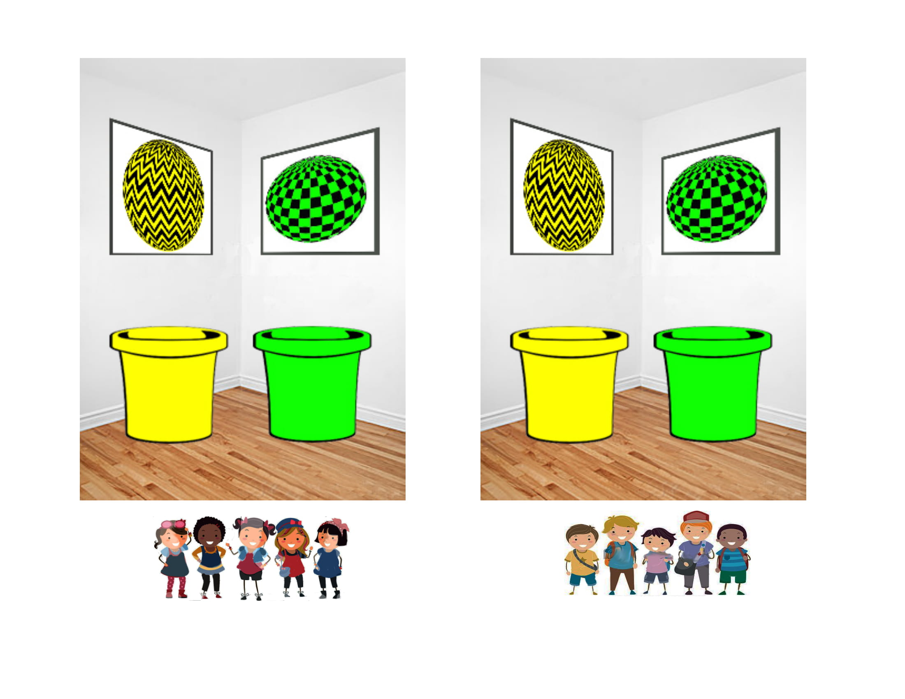
People of different genders are different in a variety of ways.
MALE
FEMALE
Notes:
We can’t help but categorize people around us into different genders. And we notice that people of different genders tend to differ in a variety of ways: have different hairstyles, wear different kinds of clothing, gravitate towards different activities, exhibit different preferences, different personalities

Slide 3
People of different genders are different in a variety of ways.
MALE
FEMALE
have short hair
have long hair
wear pants
wear dresses
like playing video games
like playing with dolls
are aggressive
are reserved
Notes:
We can’t help but categorize people around us into different genders. People of different genders tend to differ in a variety of ways: have different hairstyles, wear different kinds of clothing, gravitate towards different activities, exhibit different preferences, different personalities

Slide 4

People of different genders are different in a variety of ways.
MALE
FEMALE
have short hair
have long hair
wear pants
wear dresses
like playing video games
like playing with dolls
are aggressive
are reserved
Notes:
How do children interpret these differences? How are children reasoning about these differences with respect to their concept of gender?

Slide 5
An essentialist theory of gender
Gender categories correspond to real categories in the world.
Each category has a unique “essence” that gives rise to shared, innate, unchangeable properties.
MALE
FEMALE
Gelman 2003/2004
Notes:
One way to understand these gender differences is to take these differences as reflecting something fundamentally different between men and women.
Essentialism - cognitive bias to believe that: categories represent real distinctions in the world, category members share an “essence” that gives rise to shared properties that are innate and unchangeable

Slide 6
A social-structural theory of gender
Gender categories are (at least partly) socially constructed. Category differences emerge (at least partly) because of different social-structural forces.
MALE
FEMALE
social context of being MALE
social context of being FEMALE
Notes:
Social context of gender.
Different genders subject to different socialization, different resources, different social standards, different social biases, etc.
For illustrative purposes, I’m illustrating this theory using the gender binary, but this theory is not committed to such a dictotomy.

Slide 7
A social-structural theory of gender
An essentialist theory of gender
Notes:
How do children decide between these two contrasting theories of gender? I don’t mean to imply that these are the only views of gender that you can have, or that these are two discrete takes: presenting them here as separate theories, but I think of them as describing two opposing views with a spectrum in between.

Slide 8
A social-structural theory of gender
Language provides information about which view of gender to take.
An essentialist theory of gender
Language
Notes:
Plan for the talk:

Slide 9
A social-structural theory of gender
Language provides information about which view of gender to take.
An essentialist theory of gender
Generic language has been suggested as a linguistic cue for essentialism.
Generic language

Slide 10
A social-structural theory of gender
Language provides information about which view of gender to take.
An essentialist theory of gender
Generic language has been suggested as a linguistic cue for essentialism.
Formal explanations have been proposed as another linguistic cue for essentialism.
Formal explanations
Notes:
- Talk about a study that suggests this

Slide 11
A social-structural theory of gender
Language provides information about which view of gender to take.
An essentialist theory of gender
Generic language has been suggested as a linguistic cue for essentialism.
Formal explanations have been proposed as another linguistic cue for essentialism.
Formal explanations
Formal explanations may be compatible with either view of gender, depending on background contextual information.
Notes:
In this talk, I’d like to argue that….
I’ll show you some intuitive reasons why this might be the case, talk about a prior study that hints to something along these lines, and walk you through the current ongoing study I’m conducting to investigate this.

Slide 12
A social-structural theory of gender
Language provides information about which view of gender to take.
An essentialist theory of gender
Generic language has been suggested as a linguistic cue for essentialism.
Formal explanations have been proposed as another linguistic cue for essentialism.
Formal explanations
Formal explanations may be compatible with either view of gender, depending on background contextual information.
Can information about the social-structural context block an essentialist interpretation of a formal explanation?
Notes:
In my ongoing FYP, I’m asking… I’ll present some preliminary data and end with some open questions.

Slide 13
A social-structural view of gender
An essentialist view of gender
Language provides information about which view of gender to take.
Linguistic cues
Gelman 2003/2004
Notes:
Cultural variation in what particular social categories children essentialize
The role of social input (e.g. language) in guiding children to essentialize particular categories

Slide 14
An essentialist view of gender
the property is non-accidental and conceptually central to that category
Generic language
A social-structural view of gender
“Girls play with dolls.”
“A girl plays with dolls.”
Rhodes, Leslie, & Tworek, 2012; Cimpian & Markman 2009/2011
Notes:
What kinds of language might cue children to essentialize a category?
Generic language
Here are some examples of generics
4yo who heard generic language about a novel social category -> develop essentialist beliefs about that social category
Other linguistic cues – formal explanations?
>Ellen: there isn’t a single syntactic marker that marks something as generic -> recruit other info about predicate, category, etc to decide if something is a generic

Slide 15
Generics as a cue for essentialism
Rhodes, Leslie, & Tworek, 2012

Slide 16
An essentialist view of gender
Formal explanations
A social-structural view of gender
“Suzy plays with dolls because Suzy is a girl.”
Notes:
Formal explanations

Slide 17
Formal explanations
An essentialist view of gender
“Suzy plays with dolls because Suzy is a girl.”
An individual has a property because it is a member of a particular category.
A social-structural view of gender
Formal explanations are apt iff the property is a principled property of the category.
A principled property is an aspect, a central part of what it means to be a category member.
Prasada & Dillingham 2006/2009
Notes:
Formal explanations

Slide 18
An essentialist view of gender
the property is an inherent property of that category
Formal explanations
A social-structural view of gender
“Suzy plays with dolls because Suzy is a girl.”
Gelman, Cimpian, & Roberts, 2018
Notes:
Formal explanations

Slide 19








Formal explanations as a cue for essentialism
Animals
Gender
4 trials:
2 novel behaviors 2 novel behavioral preferences
Control explanation
It’s an elephant. It flaps its ears to cool off.
Control explanation
Margaret is a girl. She likes to eat gooseberries.
Formal explanation
It flaps its ears to cool off because it is an elephant.
Formal explanation
Margaret likes to eat gooseberries because she is a girl.
5 canonical essentialism measures after each trial
N = 104 (52/cell) 5 and 6 year olds
N = 93 (46/cell) 5 and 6 year olds
Muradoglu, Marchak, Cimpian, & Gelman, 2019
Notes:
Work presented at SRCD this year
4 diff animals: Cleans itself with its beak, flaps its ears to cool off, likes to sleep standing up, likes to eat lettuce
4 diff girls: Rides on the white horse on merry-go-rounds, puts her left sock on first, likes books about a country called Switzerland, likes to eat gooseberries -> all 5 DVs after each trial

Slide 20
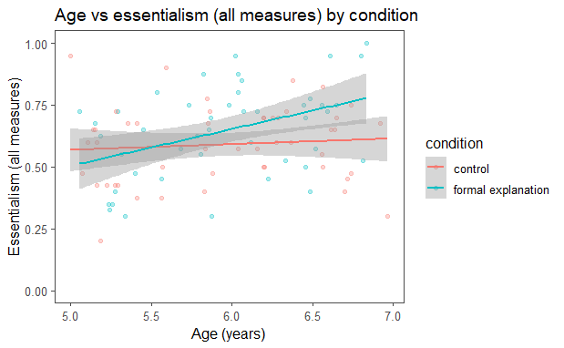
Formal explanations can cue essentialism for animal and gender categories.
Animals
essentialism = 5 canonical essentialism items x 4 trials
Gender
main effect of explanation
explanation * age interaction
main effect of explanation
N = 104 (52/cell) 5 and 6 year olds
N = 93 (46/cell) 5 and 6 year olds
Muradoglu, Marchak, Cimpian, & Gelman, 2019
Notes:
*redo the animals plot

Slide 21
An essentialist view of gender
the property is an inherent property of that category
Formal explanations
A social-structural view of gender
“Suzy plays with dolls because Suzy is a girl.”
Notes:
Previous work has suggested that formal explanations can be a cue for essentialism, perhaps because they pick out the property as an inherent property of the category.

Slide 22
An essentialist view of gender
Formal explanations may be compatible with either view of gender, depending on background contextual information.
Formal explanations
A social-structural view of gender
“Suzy plays with dolls because Suzy is a girl.”
Notes:
But here, I want to argue that actually, formal explanations can be ambiguous in a really interesting way. It’s true, sometimes we use them and interpret them in an essentialist way. But other times, I think we use them and interpret them in a non-essentialist, social-structural way.

Slide 23
An essentialist view of gender
Formal explanations may be compatible with either view of gender, depending on background contextual information.
Formal explanations
A social-structural view of gender
“Suzy plays with dolls because Suzy is a girl.”
Gelman, Cimpian, & Roberts, 2018
Notes:
In particular, when appropriate information about the social-structural context is available, we may use and interpret formal explanations in this latter way. I’ll first present some intuitive reasons for the plausibility of formal explanation having this alternate social-structural interpretation, and then I’ll talk about a study that hints at this possibility as well.

Slide 24
Formal explanations may be compatible with either view of gender, depending on background contextual information.
“Spot can’t enter the cafeteria because Spot is a dog.”
“I walk in groups late at night because I’m a woman.”
“Rosa Parks couldn’t sit in the front of the bus because she was black.”
Social-structural factors
stable extrinsic factors that act on a category by virtue of where the category is situated within a larger social structure
e.g. the social status, treatment, and experience of women in our society
CATEGORY
social context
Haslanger, 2016
Notes:
First, the intuitive reasons. So this project was in large part inspired by noticing formal explanations in the wild around me that didn’t seem to fit into the essentialist mould. Quick shoutout to Mike for the other two examples here.
- Returning to the idea of what makes for an apt formal explanation, the social experience of being __ is part of what it means to be a ___.

Slide 25
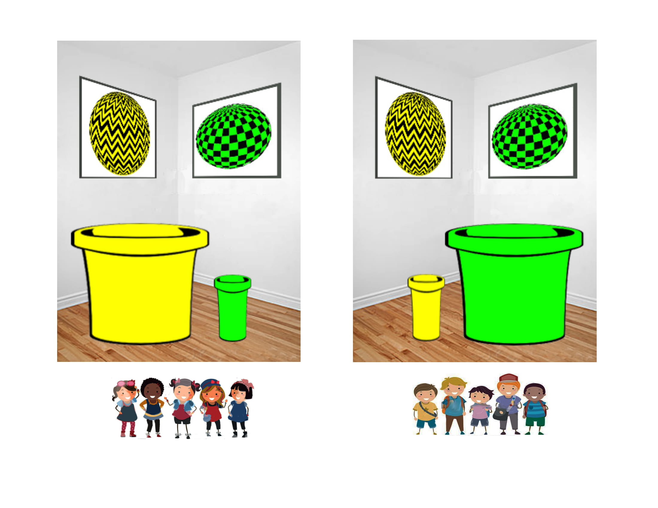
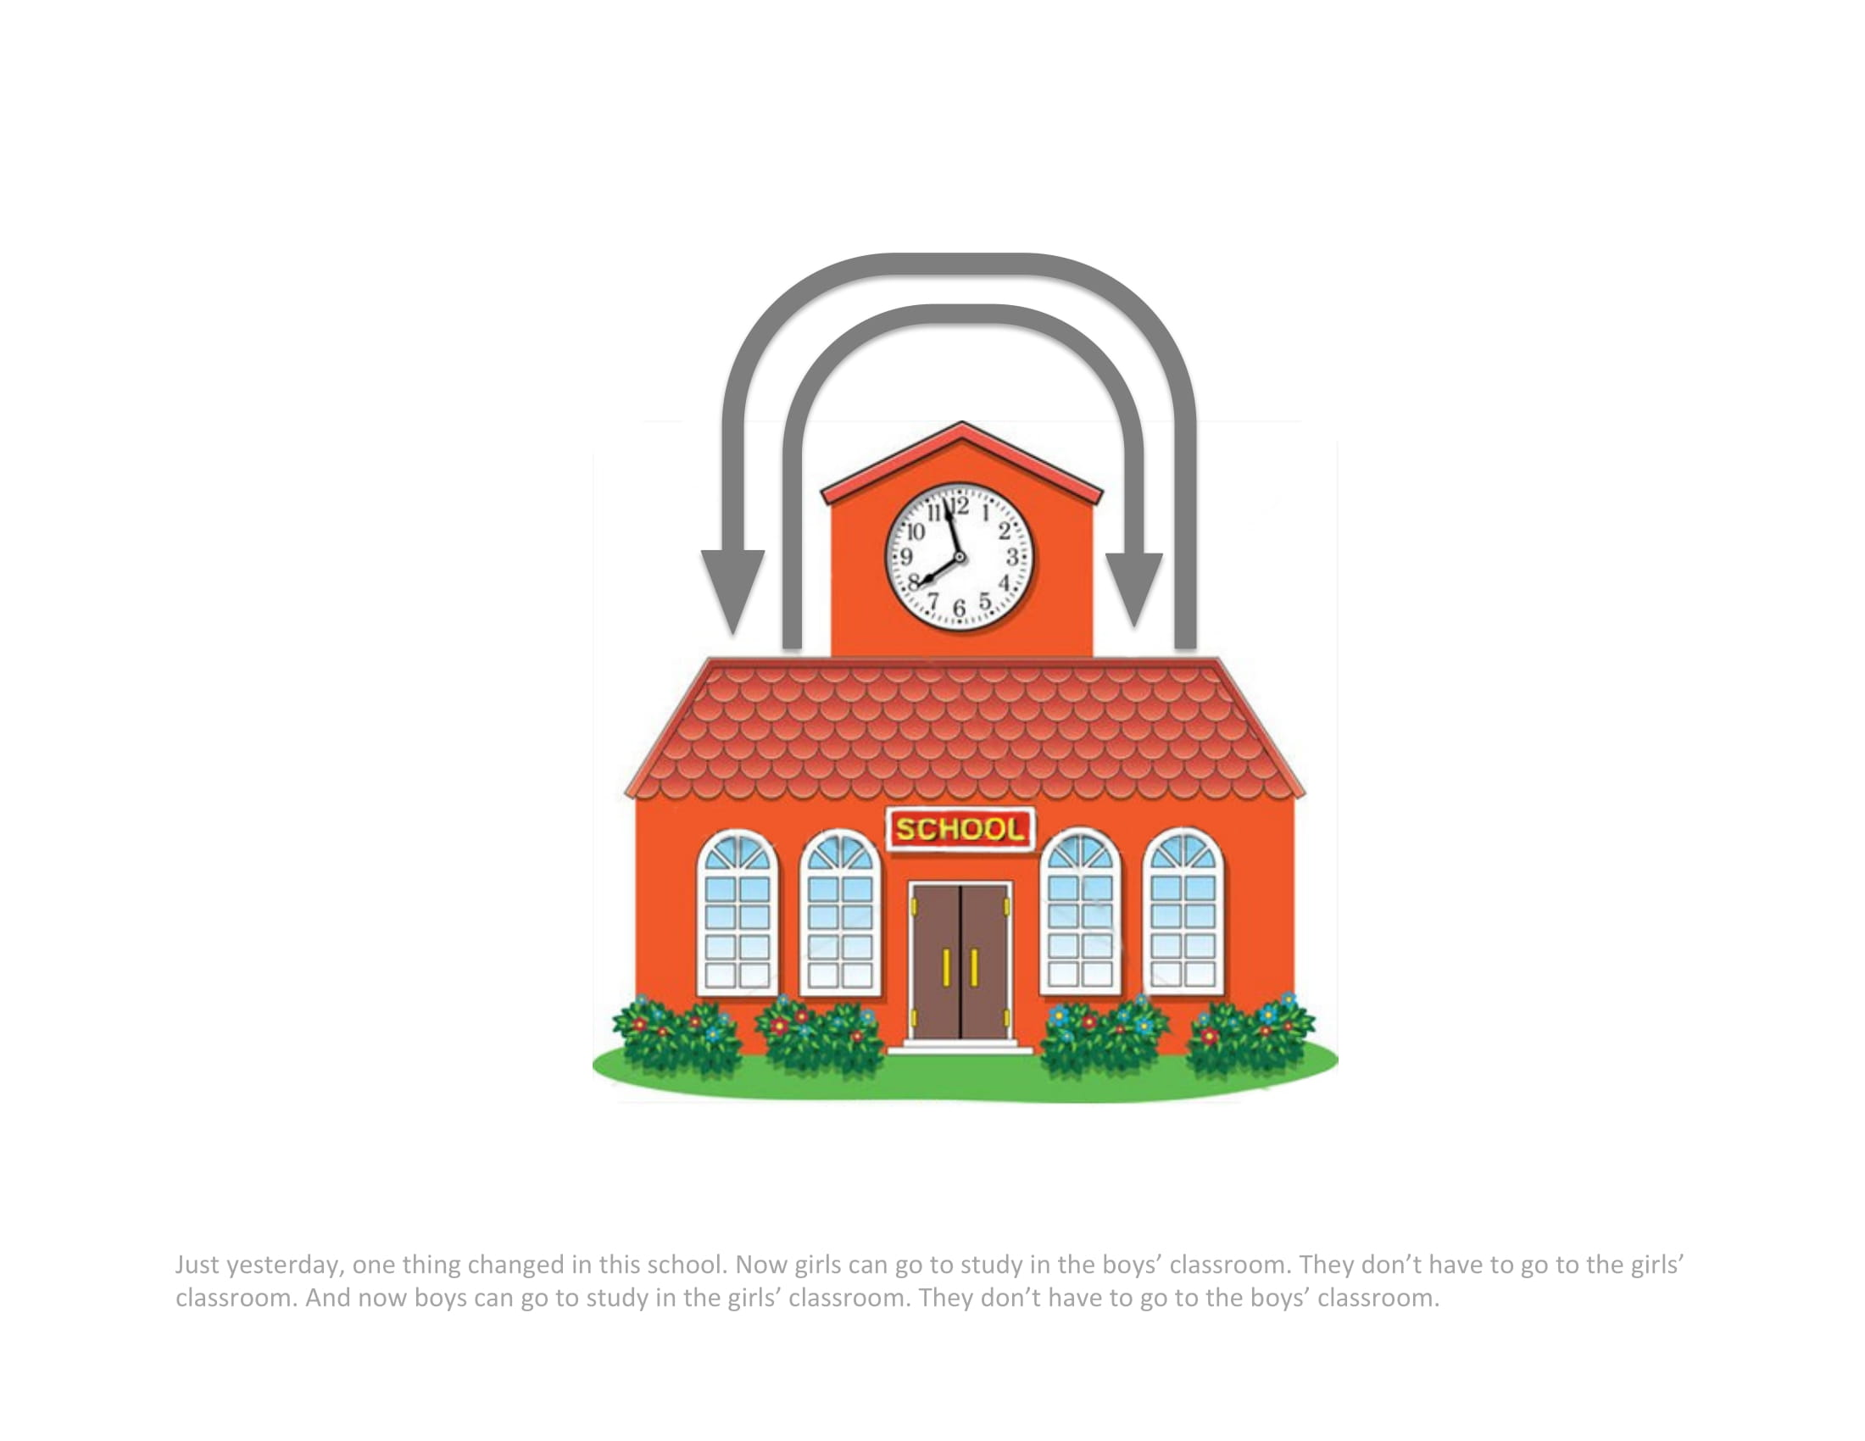
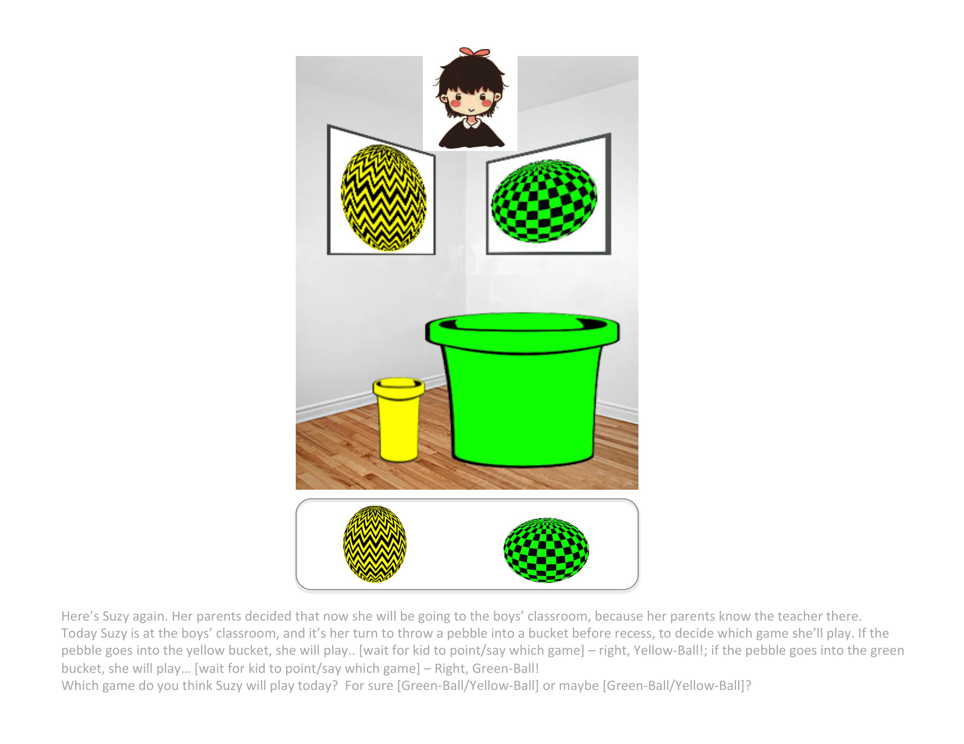
Formal explanations may be compatible with either view of gender, depending on background contextual information.
1 trial:
a novel behavior (playing a game)
Nonstructural context
Structural context
1 essentialism measure (innateness: context switch)
formal explanation rating
“Doggie, why does Suzy play Yellow-Ball?”
Doggie: “Because Suzy is a girl.”
Is it a good explanation or a bad explanation? (4-point)
Vasilyeva, Gopnik, & Lombrozo, 2018
N = 41 (20/cell) 3-4 year olds, 48 (24/cell) 5-6 year olds, 67 (33/cell) adults
Notes:
Whether to explain the Vasilyeva paradigm when I get to her study, or hold off on study details until get to my study.

Slide 26
Formal explanations may be compatible with either view of gender, depending on background contextual information.
1 trial:
a novel behavior (playing a game)
Nonstructural context
Structural context
1 essentialism measure (innateness: context switch)
Less essentialist in structural than nonstructural context.
A formal explanation was rated equally good in both contexts.
formal explanation rating
Vasilyeva, Gopnik, & Lombrozo, 2018
N = 41 (20/cell) 3-4 year olds, 48 (24/cell) 5-6 year olds, 67 (33/cell) adults
Notes:
*Whether to explain the Vasilyeva paradigm when I get to her study, or hold off on study details until get to my study.

Slide 27
Can information about a structural context block an essentialist interpretation of a formal explanation?
Context > Statistical evidence of property > Explanation > Measure essentialism
(Vasilyeva, Lombrozo, & Gopnik, 2018)
(Muradoglu et al, 2019)
(new!)
Structural context
Formal explanation
Nonstructural context
Control explanation
2x2 design
N = 38 (~9/cell) out of target 196 (49/cell) 5 and 6 year olds from Bing Nursery School, Tech Museum
N = 183 (46/cell) adults from Amazon Mechanical Turk

Slide 28
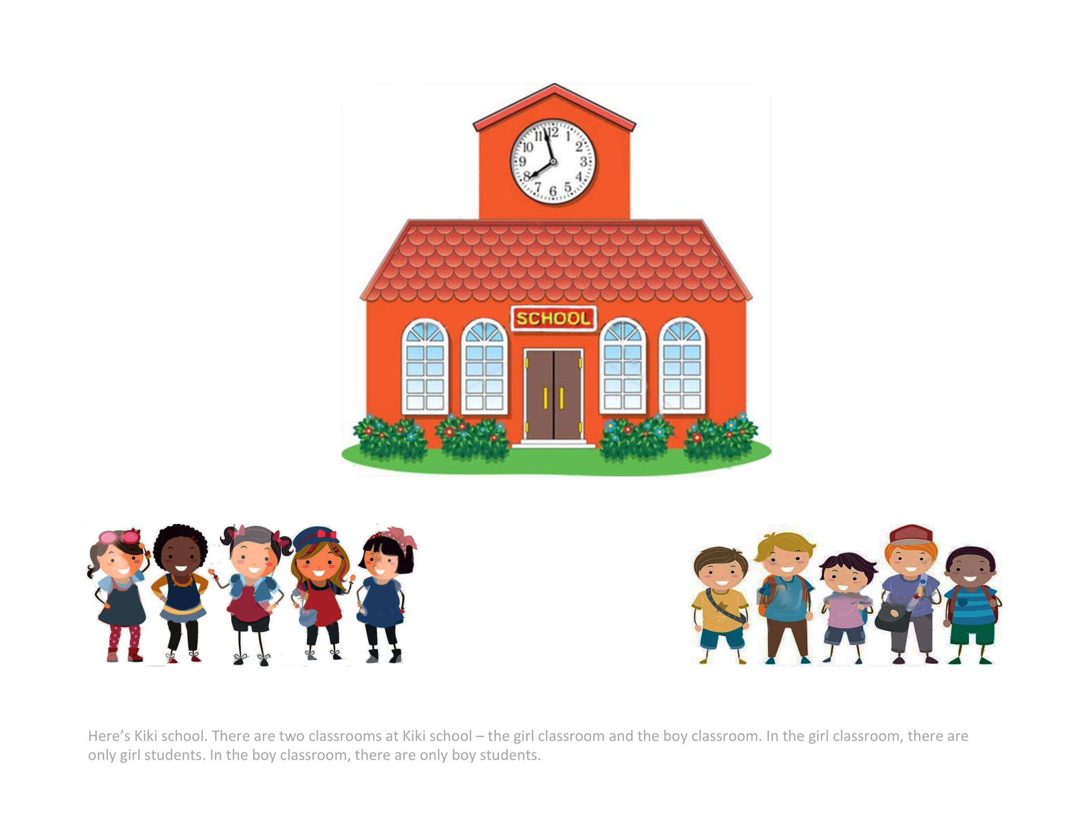
Context > Statistical evidence of property > Explanation > Measure essentialism
Gender-segregated classrooms
borrowed from Vasilyeva, Gopnik, & Lombrozo, 2018
Notes:
Here's Kiki school. There are two classrooms at Kiki school - the girl classroom and the boy classroom. In the girl classroom, there are only girl students. In the boy classroom, there are only boy students.

Slide 29
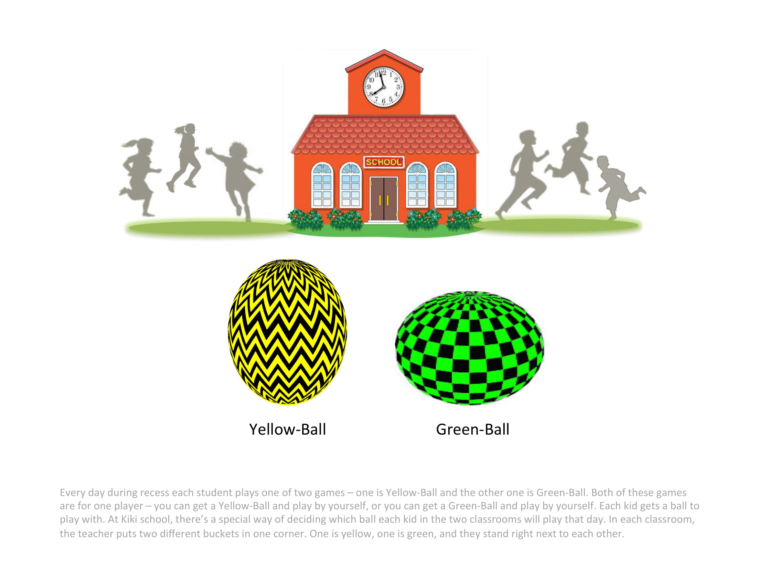
Context > Statistical evidence of property > Explanation > Measure essentialism
Gender-segregated classrooms
Novel behavior (playing games)
borrowed from Vasilyeva, Gopnik, & Lombrozo, 2018
Notes:
Every day during recess each student plays one of two games – one is Yellow-Ball and the other one is Green-Ball. Both of these games are for one player – you can get a Yellow-Ball and play by yourself, or you can get a Green-Ball and play by yourself. Each kid gets a ball to play with. At Kiki school, there’s a special way of deciding which ball each kid in the two classrooms will play that day. In each classroom, the teacher puts two different buckets in one corner. One is yellow, one is green, and they stand right next to each other.

Slide 30
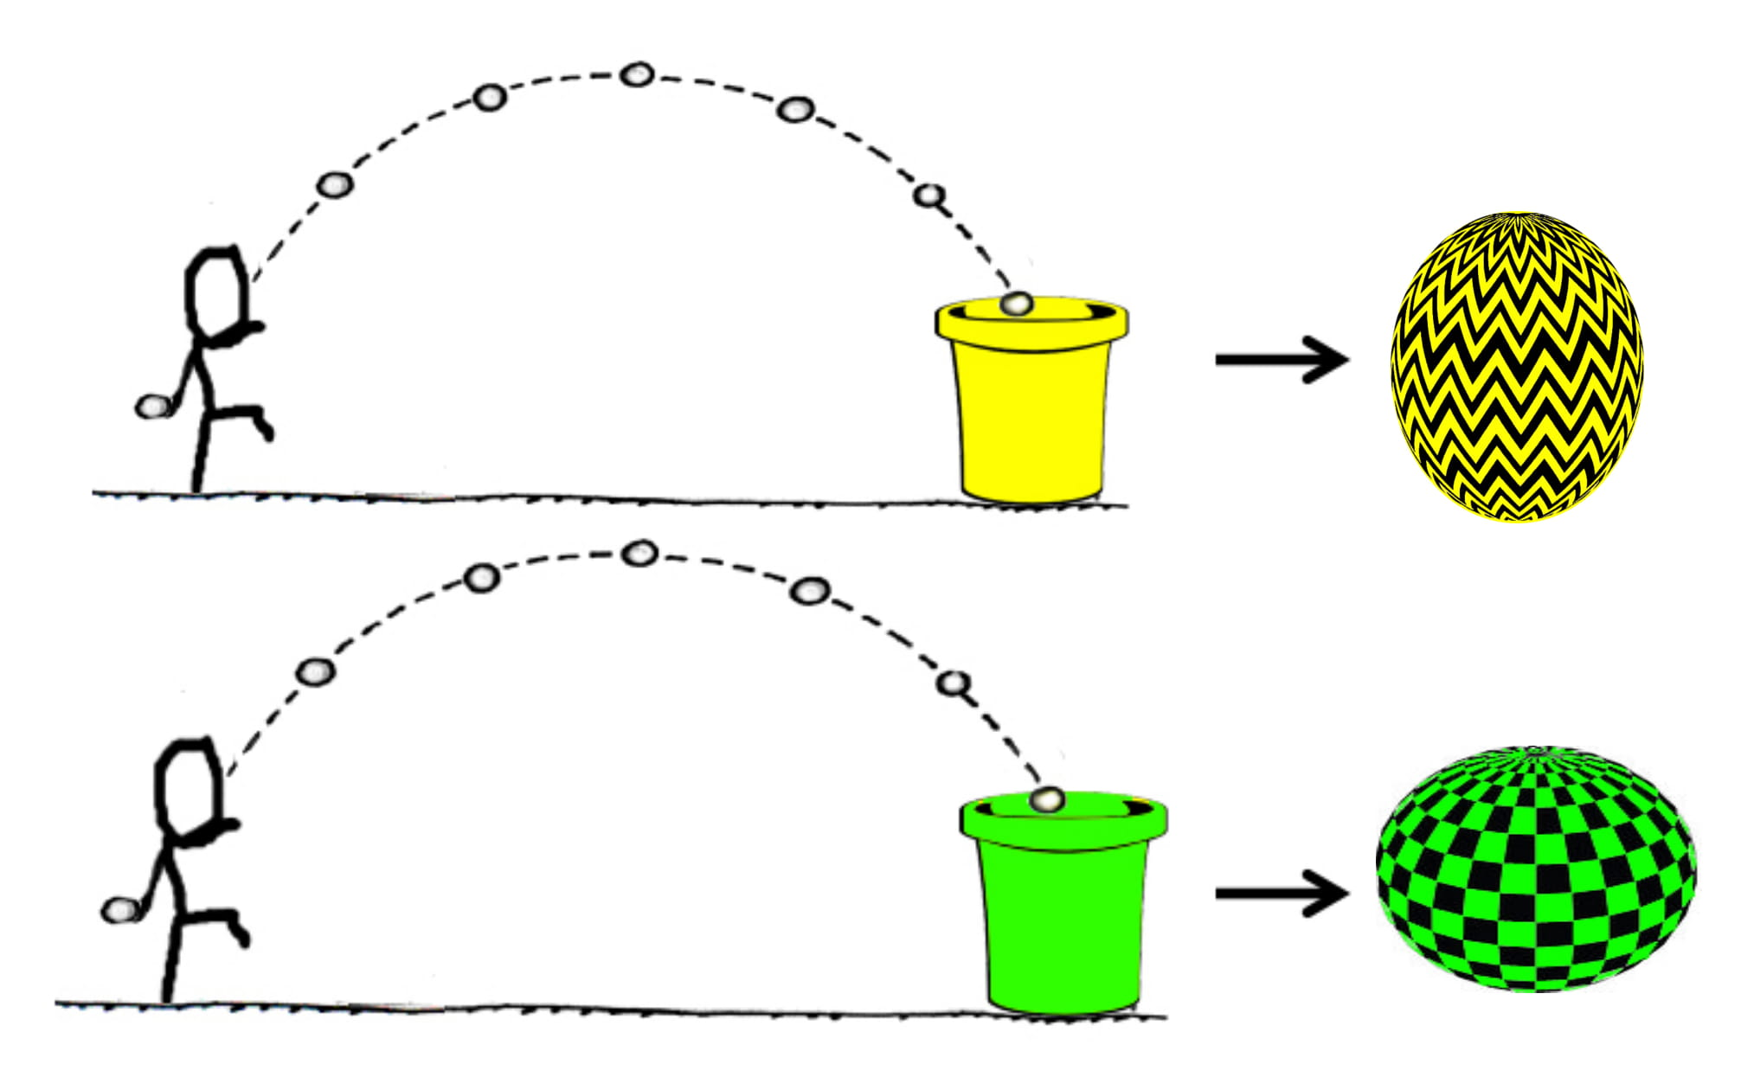
Context > Statistical evidence of property > Explanation > Measure essentialism
Gender-segregated classrooms
Novel behavior (playing games)
borrowed from Vasilyeva, Gopnik, & Lombrozo, 2018
Notes:
On the way to recess, each child stops a few steps away from the buckets and throws a pebble like this [demonstrate a throw], aiming for one of the buckets. If the pebble falls into the yellow bucket, that child plays Yellow-Ball that day. If the pebble, falls into the green bucket, that child plays Green-Ball that day. Do you see how this works?

Slide 31
Context > Statistical evidence of property > Explanation > Measure essentialism
Nonstructural context
Structural context
bucket sizes counterbalanced
Different gender categories subject to equivalent social-structural contexts
Different gender categories subject to different social-structural contexts
memory check: bucket sizes in each classroom
borrowed from Vasilyeva, Gopnik, & Lombrozo, 2018
Notes:
These are the two buckets that are always set up in the girls' classroom. You can see that at the girls’ classroom, the bucket for Yellow-Ball is also the same size as the bucket for Green-Ball, so it’s just as easy to get the pebble in the Yellow-Ball bucket than it is to get it in the Green-Ball bucket.
- Counterbalanced which bucket was bigger in the structural context * Language about difficulty -

Slide 32
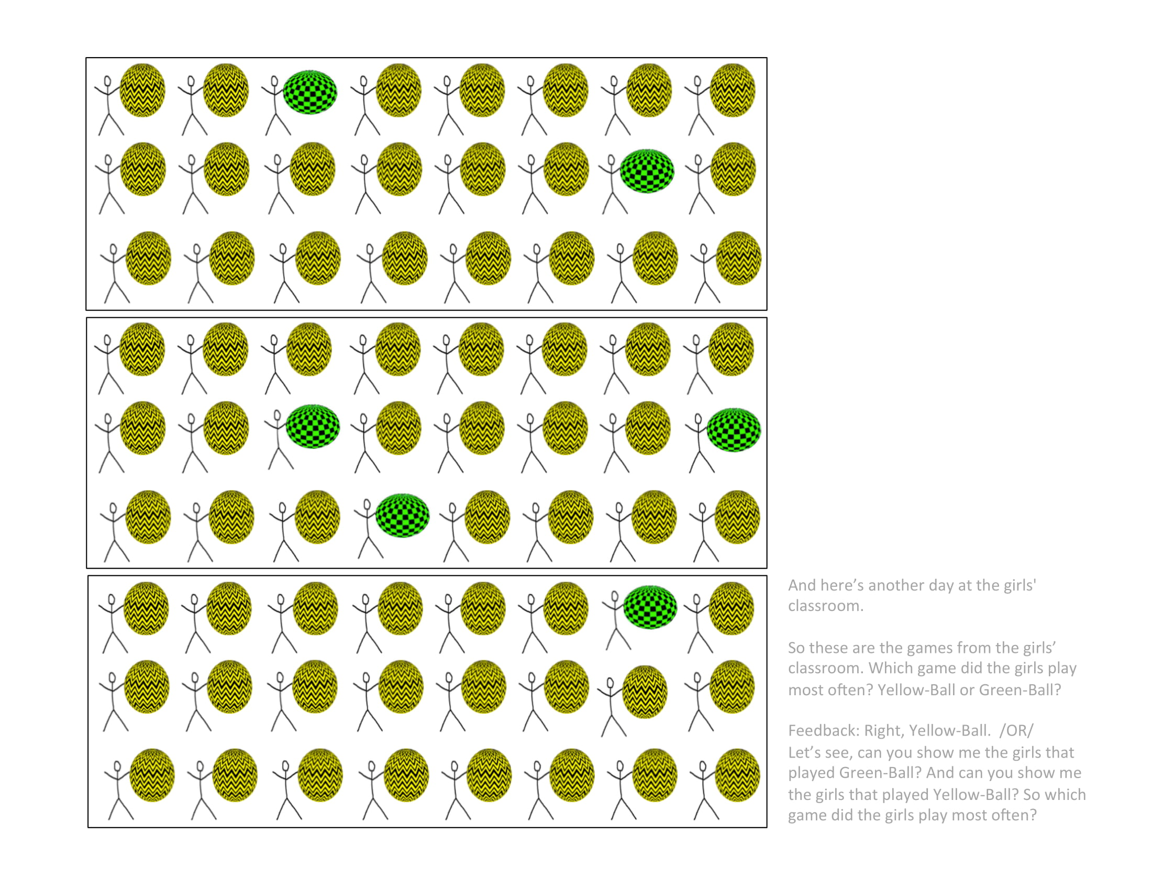
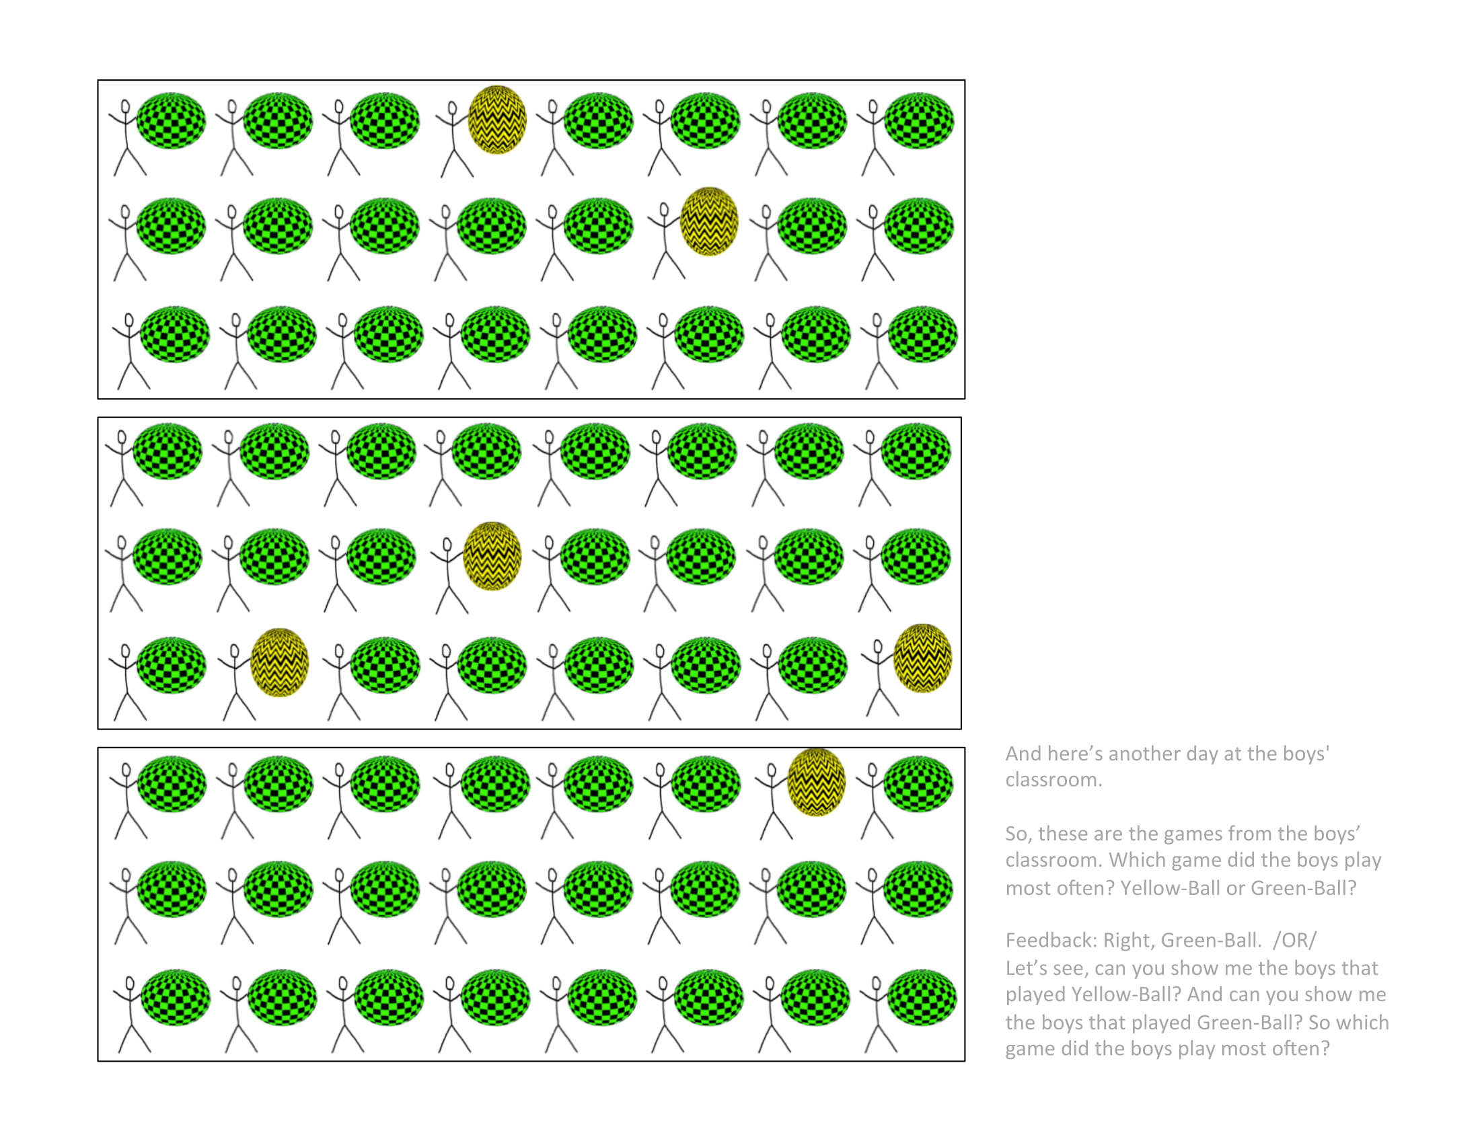
Context > Statistical evidence of property > Explanation > Measure essentialism
girls in girls’ classroom play a lot of Yellow-Ball
game
counterbalanced
boys in boys’ classroom play a lot of Green-Ball
memory check: game played most often by each gender
borrowed from Vasilyeva, Gopnik, & Lombrozo, 2018
Notes:
Memory check

Slide 33
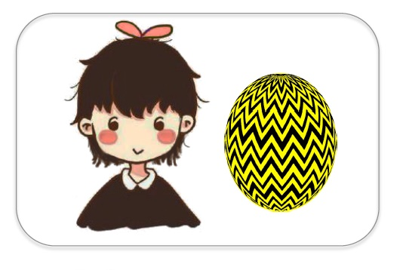
Context > Statistical evidence of property > Explanation > Measure essentialism
Control explanation
Here’s Suzy. She is a girl. She plays Yellow-Ball.
Formal explanation
Here’s Suzy. She plays Yellow-Ball because she is a girl.
adapted from Muradoglu, Marchak, Cimpian, & Gelman, 2019

Slide 34
Context > Statistical evidence of property > Explanation > Measure essentialism
DVs from Muradoglu, Marchak, Cimpian, & Gelman, 2019
Notes:
Initial thought: let’s use the 5 canonical essentialism items from Muradoglu et al, and adapt them to this classroom context

Slide 35

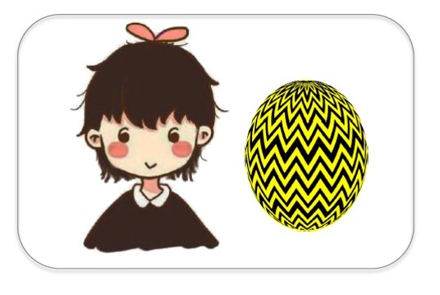







Context > Statistical evidence of property > Explanation > Measure essentialism
A canonical essentialism battery: 5 items averaged into essentialism score per participant
Stability past | Now, here’s a question for you: Suzy is 8 years old. Do you think she played Yellow-Ball when she was 4 years old? (Y/N)
Stability future | Do you think she will always play Yellow-Ball? (Y/N)
Innateness stop | Would Suzy stop playing Yellow-Ball if her family tried to stop her from playing Yellow-Ball? (Y/N)
Inductive potential | Do you think “just this girl,” “a few girls,” or “a whole lot of girls” play Yellow-Ball? (3-point)
Innateness switch | [Suzy goes to boys classroom] Which game do you think Suzy will play today? __ For sure __ or maybe __? (4-point)
------ Muradoglu et al, 2019 ------
Vasilyeva et al

Slide 36
Context > Statistical evidence of property > Explanation > Measure essentialism
 |  | Essentialist | Structural
Stability past | Now, here’s a question for you: Suzy is 8 years old. Do you think she played Yellow-Ball when she was 4 years old? (Y/N) | Yes | Not same school: No Same school: Yes
Stability future | Do you think she will always play Yellow-Ball? (Y/N) | Yes | Not same school: No?
Innateness stop | Would Suzy stop playing Yellow-Ball if her family tried to stop her from playing Yellow-Ball? (Y/N) | No | No?
Inductive potential | Do you think “just this girl,” “a few girls,” or “a whole lot of girls” play Yellow-Ball? | A whole lot | At this school: A whole lot Outside school: ?
Innateness switch | [Suzy goes to boys classroom] Which game do you think Suzy will play today? __ For sure __ or maybe __? | For sure Yellow-Ball | For sure Green-Ball
A canonical essentialism battery: 5 items
------ Muradoglu et al, 2019 ------
Vasilyeva et al
Notes:
Characteristic answers to these questions that signal essentialism

Slide 37
Context > Statistical evidence of property > Explanation > Measure essentialism
 |  | Essentialist | Structural
Stability past | Now, here’s a question for you: Suzy is 8 years old. Do you think she played Yellow-Ball when she was 4 years old? (Y/N) | Yes | Not same school: No Same school: Yes
Stability future | Do you think she will always play Yellow-Ball? (Y/N) | Yes | Not same school: No?
Innateness stop | Would Suzy stop playing Yellow-Ball if her family tried to stop her from playing Yellow-Ball? (Y/N) | No | No?
Inductive potential | Do you think “just this girl,” “a few girls,” or “a whole lot of girls” play Yellow-Ball? | A whole lot | At this school: A whole lot Outside school: ?
Innateness switch | [Suzy goes to boys classroom] Which game do you think Suzy will play today? __ For sure __ or maybe __? | For sure Yellow-Ball | For sure Green-Ball
A canonical essentialism battery: 5 items averaged
------ Muradoglu et al, 2019 ------
Vasilyeva et al
Notes:
But if we compare what someone
Besides for innateness switch, items don’t clearly tease apart essentialism from other ways of thinking

Slide 38
Context > Statistical evidence of property > Explanation > Measure essentialism
A new essentialism battery: 3 items averaged
 |  | Essentialist | Structural
Force-choice explanation | So, Suzy plays Yellow-Ball a lot at her school. Is it because Suzy likes playing Yellow-Ball, or is it because of the size of the buckets in her classroom? | Preference | Buckets
Inductive potential | Here’s Lucy. Lucy is a girl who doesn’t go to Kiki school. She goes to another school, where there aren’t any buckets. What game do you think Lucy will play? __ For sure __ or maybe __? (4-point) | Yellow-Ball | Chance
Innateness switch | [Suzy goes to boys classroom] Which game do you think Suzy will play today? __ For sure __ or maybe __? (4-point) | For sure Yellow-Ball | For sure Green-Ball
-------- New-------
Vasilyeva et al
Notes:
After multiple rounds of piloting, we came up with a new battery of items to measure essentialism
Fixed order

Slide 39
Context > Statistical evidence of property > Explanation > Measure essentialism
A new essentialism battery: 3 items averaged
 |  | Essentialist | Structural
Force-choice explanation | So, Suzy plays Yellow-Ball a lot at her school. Is it because Suzy likes playing Yellow-Ball, or is it because of the size of the buckets in her classroom? | Preference | Buckets
Inductive potential | Here’s Lucy. Lucy is a girl who doesn’t go to Kiki school. She goes to another school, where there aren’t any buckets. What game do you think Lucy will play? __ For sure __ or maybe __? (4-point) | Yellow-Ball | Chance
-------- New-------
Normative | Would it be okay or not okay for girls to play Green-Ball? | Not okay | Okay
Exploratory
Innateness switch | [Suzy goes to boys classroom] Which game do you think Suzy will play today? __ For sure __ or maybe __? (4-point) | For sure Yellow-Ball | For sure Green-Ball
Vasilyeva et al
Notes:
Also an exploratory normative measure that we administered between the inductive potential and innateness switch items
* Should I mention this?

Slide 40
Context > Statistical evidence of property > Explanation > Measure essentialism
A new essentialism battery: 3 items averaged
 |  | Essentialist | Structural
Force-choice explanation | So, Suzy plays Yellow-Ball a lot at her school. Is it because Suzy likes playing Yellow-Ball, or is it because of the size of the buckets in her classroom? | Preference | Buckets
Inductive potential | Here’s Lucy. Lucy is a girl who doesn’t go to Kiki school. She goes to another school, where there aren’t any buckets. What game do you think Lucy will play? __ For sure __ or maybe __? (4-point) | Yellow-Ball | Chance
Innateness switch | [Suzy goes to boys classroom] Which game do you think Suzy will play today? __ For sure __ or maybe __? (4-point) | For sure Yellow-Ball | For sure Green-Ball
-------- New-------
Vasilyeva et al
Notes:
But only these 3 items were averaged. Explain coding.
*Force-choice: preference may not necessarily be essential

Slide 41
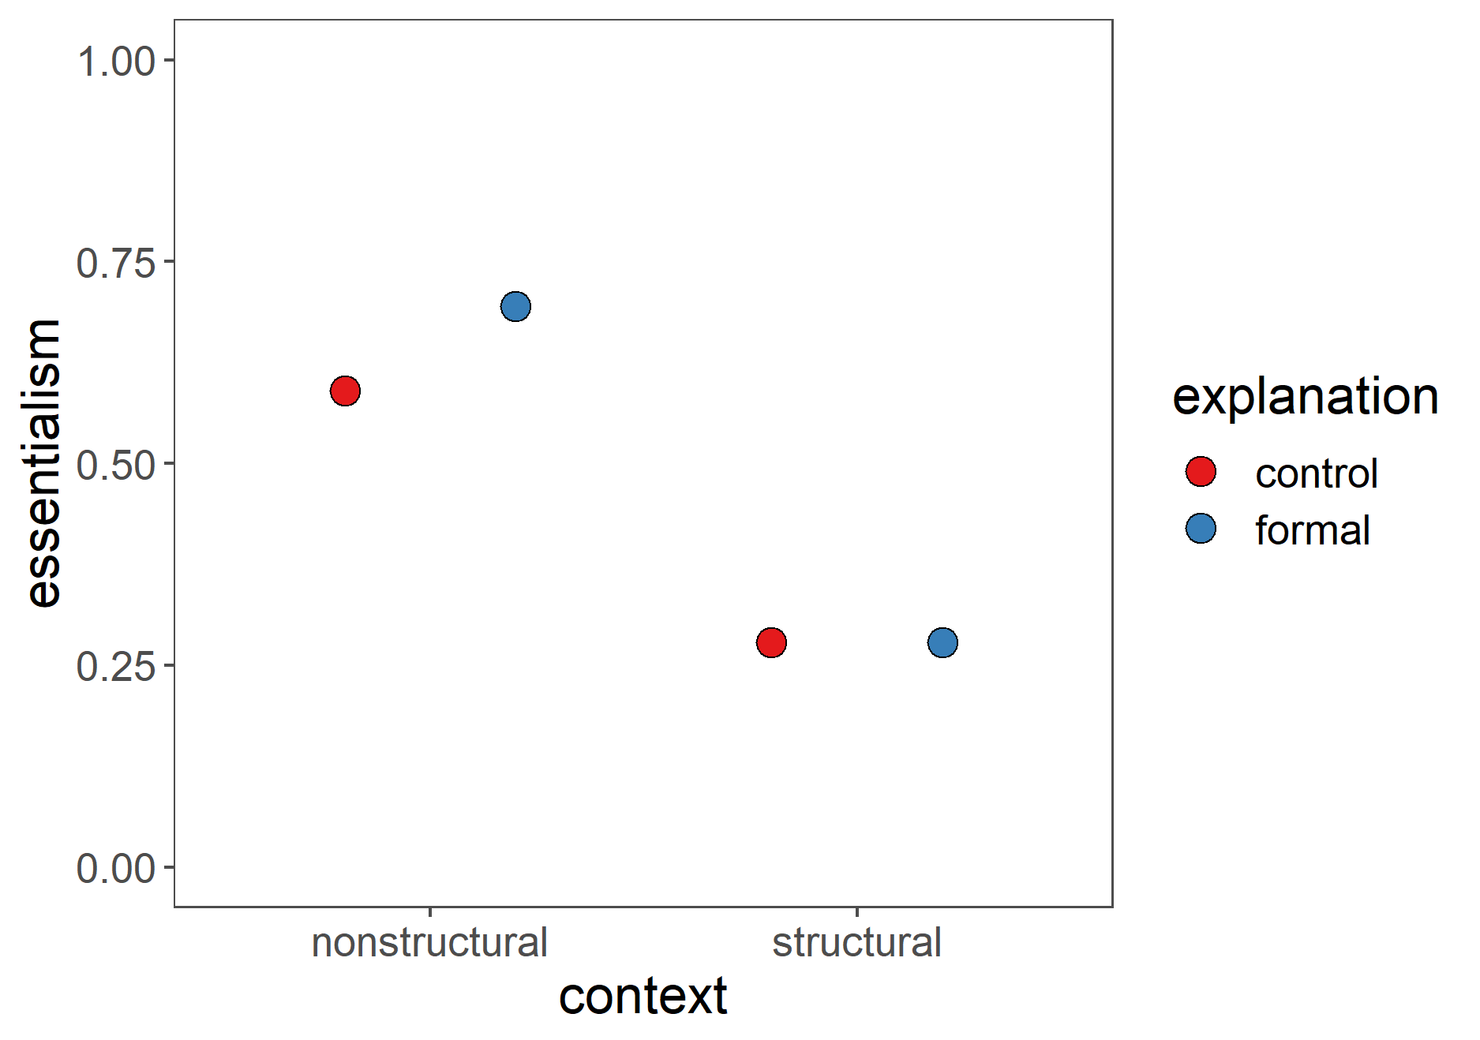
A social-structural theory of gender
Context > Statistical evidence of property > Explanation > Measure essentialism
An essentialist theory of gender
Formal explanations
Notes:
Essentialism = for each subject, average 3 essentialism items, and then the averages over that. 1 is more essentialist, 0 is less.

Slide 42

A social-structural theory of gender
Context > Statistical evidence of property > Explanation > Measure essentialism
prediction:
context * explanation
An essentialist theory of gender
Formal explanations
prediction based on Muradoglu, Marchak, Cimpian, & Gelman, 2019
Notes:
Based on Muradoglu et al, predict simple effect of formal explanations boosting essentialism in the nonstructural condition

Slide 43
A social-structural theory of gender
Context > Statistical evidence of property > Explanation > Measure essentialism
prediction:
context * explanation
An essentialist theory of gender
prediction based on Vasilyeva, Gopnik, & Lombrozo, 2018
Notes:
Based on Vasilyeva et al, predict a simple effect of structural context decreasing essentialism when given a control explanation

Slide 44

A social-structural theory of gender
Context > Statistical evidence of property > Explanation > Measure essentialism
prediction:
context * explanation
An essentialist theory of gender
Formal explanations

Slide 45
A social-structural theory of gender
Context > Statistical evidence of property > Explanation > Measure essentialism
prediction:
context * explanation
An essentialist theory of gender
Formal explanations

Slide 46
A social-structural theory of gender
Context > Statistical evidence of property > Explanation > Measure essentialism
prediction:
context * explanation
An essentialist theory of gender
Formal explanations

Slide 47
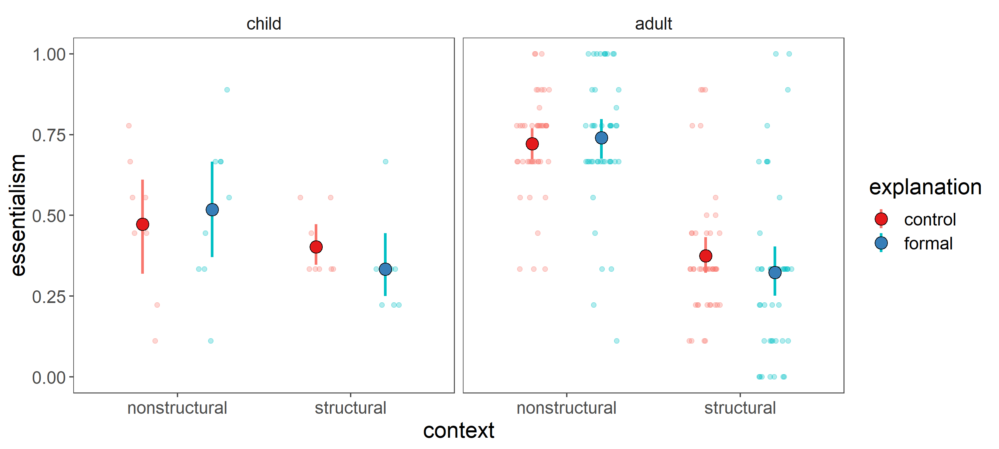
Context > Statistical evidence of property > Explanation > Measure essentialism
Error bars = 95% CIs
N = 38 (~9/cell) out of target 196 (49/cell) 5 and 6 year olds
N = 183 (46/cell) adults

Slide 48
Context > Statistical evidence of property > Explanation > Measure essentialism
main effect of context
Error bars = 95% CIs
N = 38 (~9/cell) out of target 196 (49/cell) 5 and 6 year olds
N = 183 (46/cell) adults

Slide 49
A social-structural theory of gender
An essentialist theory of gender
Formal explanations

Slide 50
A social-structural theory of gender
Language provides information about which view of gender to take.
An essentialist theory of gender
Formal explanations may be compatible with either view of gender, depending on background contextual information.
Formal explanations

Slide 51
A social-structural theory of gender
Language provides information about which view of gender to take.
An essentialist theory of gender
What is essentialism? Which of its features hang together? Which are most central?
How can we best measure essentialism?
Formal explanations may be compatible with either view of gender, depending on background contextual information.
Formal explanations
What are formal explanations? When do we produce them?
How do we interpret them?
“simply/just because”?
How do we reason about the necessity vs contingency of category properties?
How do we learn about the social-structural context? When do we consider such information?
When developmentally and in what domains do children engage in structural thinking?
Notes:
Statistical confound
Formal explanations – when do we produce them (so brief, almost tautological) vs fully fledged structural explanation (“well I walk in groups late at night because unfortunately the likelihood of women being targeted for harassment and violence by predatory men increases during the night hours”), pragmatics of brevity?

Slide 53



Thanks!
Ellen Markman
Cai Guo
Kara Weisman
Lin Bian
Derek Powell
Nadya Vasilyeva
Kristan Marchak
Melis Muradoglu
Hyo Gweon
Mika Asaba
Natalia Vélez
Sophie Bridgers
Mike Frank
Steven Roberts
Chia-Wa Yeh
github.com/mariannazhang

Slide 54
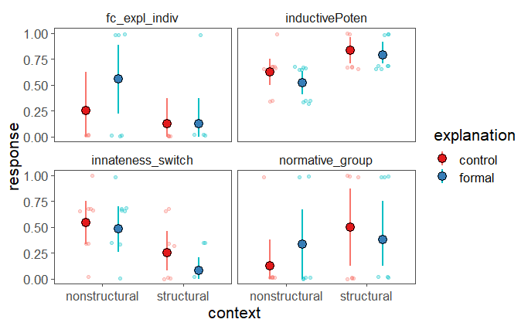
Essentialism by DV
Inductive potential:
Why the context pattern?
N = 38 (~9/cell) out of target 196 (49/cell) 5 and 6 year olds

